Slide 1
Dairy goods sales prediction
Project Mentor :
Prof. Arnab Chakraborty
Team Members :
Vishwanath.R

Slide 2
Contents
Project Objective & Scope
Data Description
Methodology
Data Preprocessing
Models Used
Accuracy Comparison
Mean Absolute Error Comparison
Future Scope of Improvements

Slide 3
Project objective & scope
Objective:
Given : A small dairy goods sales prediction application, dataset taken from Kaggle (contains training and test data).
Goal : To Predict the sales of the dairy products.
Finally : Apply on the test dataset and compare the differences in the results.
Scope :
It is a useful project as the regression models can be used to quickly determine the sales prediction.
The results might have some mismatch with the real-world applications. But that can be avoided if the models are trained for small datasets.

Slide 4
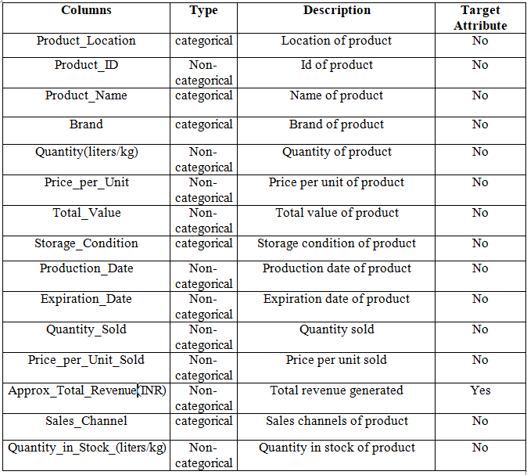
Data description
The description of the data with type and description of each Attribute is given/shown in the table.

Slide 5
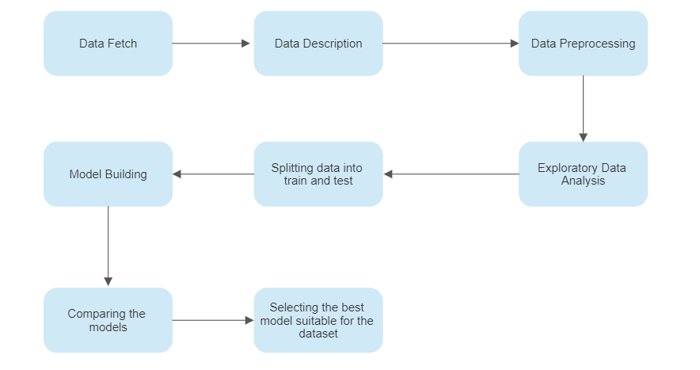
Methodology

Slide 6
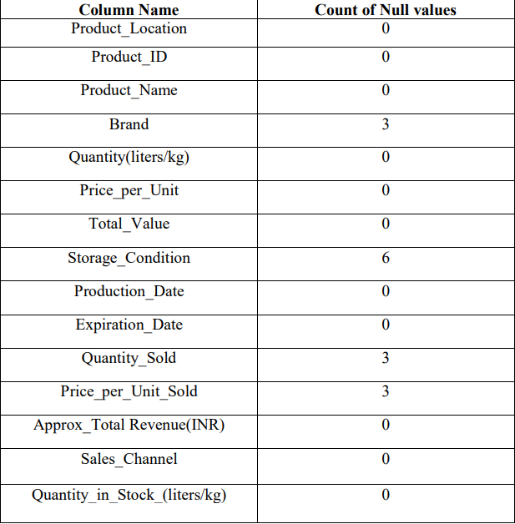
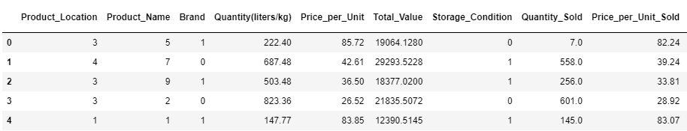
Data Preprocessing
Firstly we have to fill the null values in the dataset.
Then, we have changed the categorical values into numeric values.

Slide 7
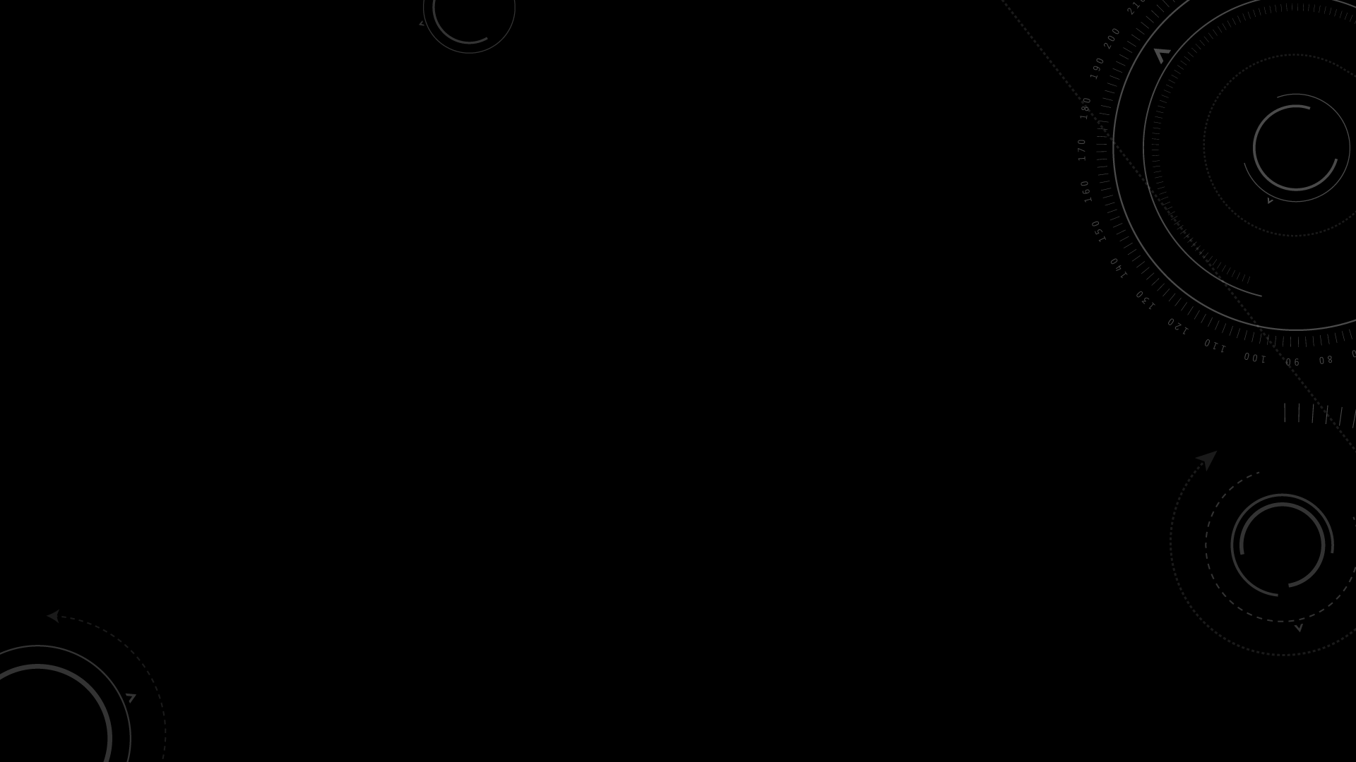
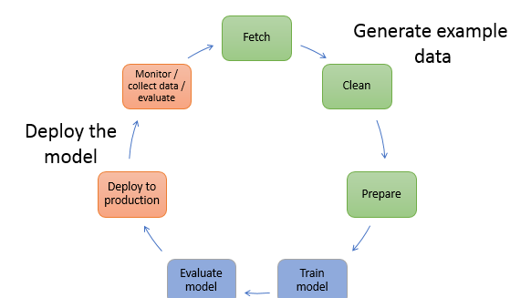
ModelS used
The Machine Learning models used for this project are:
Linear Regression
Lasso
Random Forest Regressor
Ridge

Slide 8

LINEAR REGRESSION
Linear Regression is an algorithm that belongs to supervised Machine Learning. It tries to apply relations that will predict the outcome of an event based on the independent variable data points. The relation is usually a straight line that best fits the different data points as close as possible.
Linear regression can be expressed mathematically as:
Y= Dependent Variable
X= Independent Variable
β 0= intercept of the line
β1 = Linear regression coefficient (slope of the line)
ε = random error

Slide 9
LASSO
The full form of LASSO is the Least Absolute Shrinkage and Selection Operation. As the name suggests, LASSO uses the “shrinkage” technique in which coefficients are determined, which get shrunk towards the central point as the mean.
The LASSO regression in regularization is based on simple models that posses fewer parameters. We get a better interpretation of the models due to the shrinkage process. The shrinkage process also enables the identification of variables strongly associated with variables corresponding to the target.
Lasso regression is also called Penalized regression method. This method is usually used in machine learning for the selection of the subset of variables. It provides greater prediction accuracy as compared to other regression models. Lasso Regularization helps to increase model interpretation.
The less important features of a dataset are penalized by the lasso regression. The coefficients of this dataset are made zero leading to their elimination. The dataset with high dimensions and correlation is well suited for lasso regression.
Lasso Regression Formula:
D= Residual Sum of Squares or Least Squares Lambda * Aggregate of absolute values of coefficients
Lambda denotes the amount of shrinkage in the lasso regression equation.

Slide 10
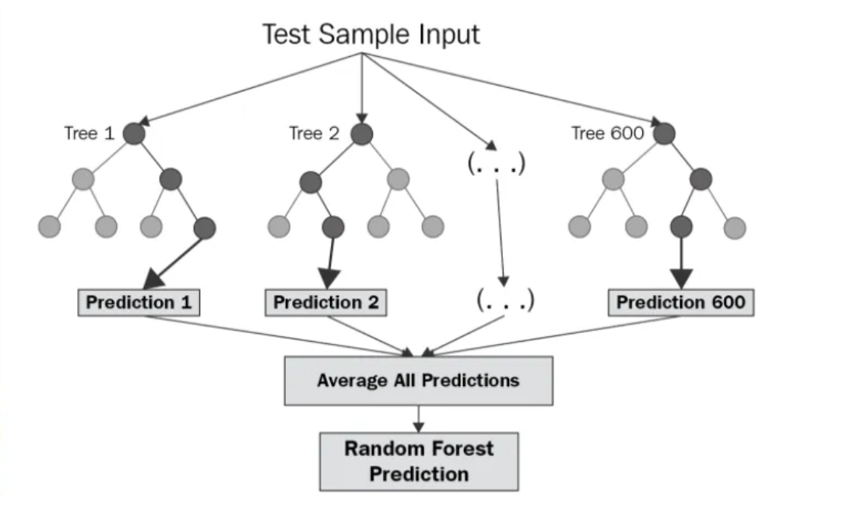
RANDOM FOREST REGRESSOR
Random Forest Regression is a supervised learning algorithm that uses ensemble learning method for regression. Ensemble learning method is a technique that combines predictions from multiple machine learning algorithms to make a more accurate prediction than a single model.

Slide 11
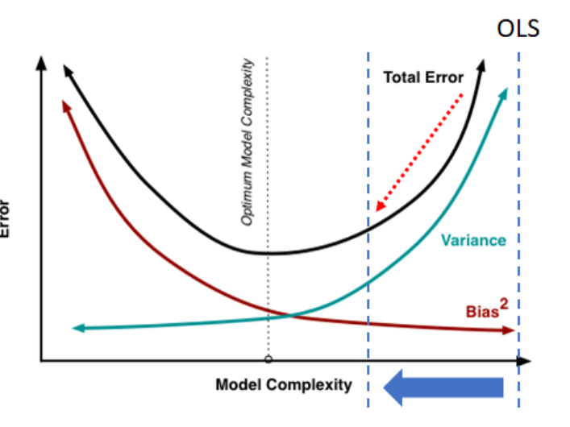
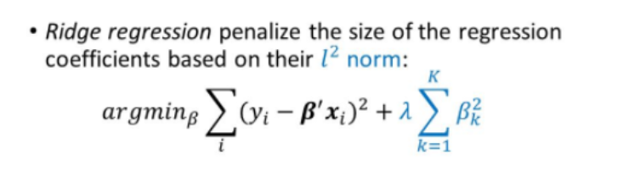
RIDGE
Ridge regression is a specialized technique used to analyze multiple regression data that is multi collinear in nature. It is a fundamental regularization technique, but it is not used very widely because of the complex science behind it. However, it is fairly easy to explore the science behind ridge regression in r if you have an overall idea of the concept of multiple regression. Regression stays the same, but in regularization, the way the model coefficients are determined is different.

Slide 12
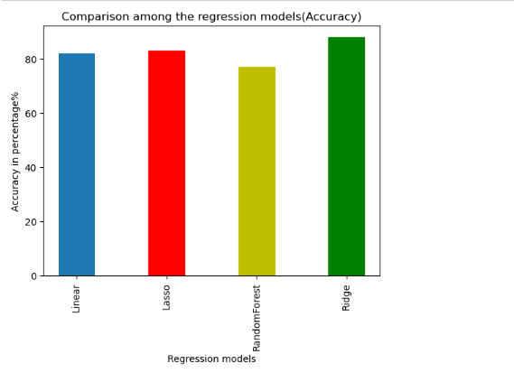
Accuracy comparison graph
Models Used | Accuracy %
Linear Regression | 82.0
Lasso | 83.0
Random Forest Regressor | 77.0
Ridge | 88.0
The data shown above is an average of multiple test runs.
We see that the highest accuracy for the train dataset is Ridge.
So we select Ridge model to predict the test dataset.

Slide 13
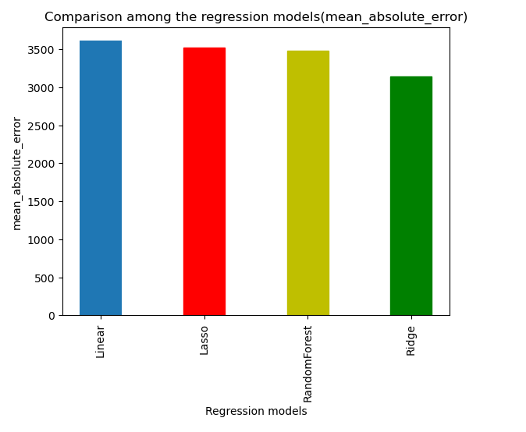
Mean_absolute_error comparison graph
Models Used | Mean absolute_error
Linear Regression | 3610.290759970679
Lasso | 3525.013044916586
Random Forest Regressor | 3478.404096666664
Ridge | 3146.158601830517
We see that the Ridge model has least Mean absolute error.

Slide 14
Future scope of improvements
Various product based companies use these models and modify them according to their needs to use in sales. This will reduce the manual labour and time spent.
Companies who intend to sell products online, retail or wholesale can use these trained models to check whether their sales prediction is correct or not. The trained models would be required to be implemented in a platform or interface easily accessible as well as with an easy GUI.
And more improvement can be done in this application by adding customer detail more precisely and fulfilling there needs accordingly with their past order records.
Post delivery of the product customer reviews/feedback survey information should be collected and attached in database for future requirements.

Slide 15
Thank you
Lovely Professional University
Vishwanath.R ( vishwanathrajkumar87@gmail.com )

